Slide 1
Michigan Statistics Poster Competition
Kick Off
Rosemarie Cybulski
Macomb Mathematics, Science, Technology Center
Begin

Slide 2
Main Menu
What is a
Statistics Poster?
How Can I Enter?
Rules
Judging
Prizes
Due Dates
Steps
Winners
Quiz

Slide 3
What is a Statistics Poster?
It is a visual display that uses two or more related graphs, that each impart different information: to summarize, discuss different points of view, and answer questions about the data.
In a well done statistics poster the reader is able to discover the story behind the data by following the logical progression of the poster.
The emphasis is on the visual display of results through well-placed graphs.

Slide 4
How Can I Enter?
If you do a great job and all the statistics are correct on your poster, Mrs. Cybulski will enter your poster automatically. (most posters get entered)
Every pair or group of 3 students is required to make a poster as part of this class.
Yes, this will be a substantial part of your grade.

Slide 5
Rules
Posters are to measure between 18 to 24 inches by 24 to 30 inches.
Any weight of paper is permitted. Standard poster board is recommended.
Be sure that anything attached to the front of the poster is affixed securely. Do not attach perishable items.
Posters must be the original design and creation of the students.
In the 10th -12th grade category, at least two graphs are required. The two graphs should impart different information (e.g., a bar graph and a pie chart of the same variable does not meet this criteria). Computer generated graphs are acceptable.

Slide 6
Rules Continued
Subject matter is the choice of the participants. Data may be original or published. For published data, a reference must be given.
A brief description including the method of collection and purpose must be securely attached to the back of the poster.
Posters and the brief description must NOT contain any marks, names, or information that reveal the identity of the individual, team, school, or location.
Students must work in teams of two.

Slide 7
Judging
Entries will be judged within the10th – 12th grade-level category on the basis of:
Clarity of Message:
  Graphs are appropriate for the data.
  Important relationships and patterns in the data stand out.
  Conclusions stand alone without the explanatory paragraph on the back.
Content:
  Importance of topic relative to grade category

Slide 8
Judging Continued
Overall Impact of the Display:
  Does the poster catch your eye?
  Does the poster draw you into the investigation?
Creativity:
  Poster is unique in content and display
  Judging is done by graduate statistics students at Grand Valley State University
  Click here for GVSU rubric Click here for my rubric

Slide 9
Prizes
Prizes in the amounts of $72, $48, and $36 will be awarded to 1st, 2nd, and 3rd place in each of the grade level categories.
Winning entrants' schools will receive plaques signifying the honor.
Honorable mention certificates will also be awarded
Winners will be posted on the GVSU website April , 2020.
Winners will be awarded April 6th, 2020
Due to scheduling conflicts this year winning posters will be not be displayed at the Michigan Science Olympiad in the GVSU Fieldhouse on the Allendale campus.

Slide 10
Due Dates
Poster Plan Sheet Mon. Nov. 11, 2019
Type of statistical test and Mon. Dec. 9, 2019
why it is appropriate for your
data. Question Sheet
Final Poster Friday. Jan. 10, 2020

Slide 11
Step 1
Develop a question/problem statement
    Example: What is the effect of running 1minute on heart rate?
    Who has a better body image, males or females? Athletes or non-athletes?
  Selecting a Topic – go to this link and read hints on how to go about selecting a good topic. Answer the corresponding questions on the worksheet and turn it in today.

Slide 12
Step 2
Plan how to gather data.
Selecting a Topic go back to this site and find the four ways to collect data write your answer on the worksheet next to the corresponding question.

Slide 13
Step 3
Display the data in an appropriate way
  Use various plots, charts, graphs, or models
  Discuss means, medians, standard deviations,
  trends, patterns, outliers, skewness etc. as appropriate.
Go to this site, constructing graphs ,for more information on graphing and to answer the corresponding questions on your worksheet.

Slide 14
Step 4
Conclusion
  Make sure your graphs answer your original question.
  Does the data suggest a significant difference between the groups?
– go back to the constructing graphs site. In the conclusion, what 3 things does it say that it can display with a little thought and creativity?
Putting it all together – go to this link for suggestions on how to put it all together and for answers to your worksheet questions.

Slide 15
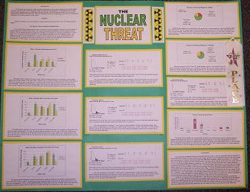
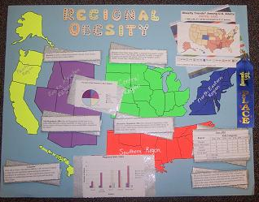
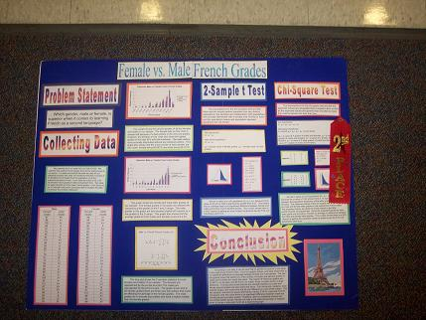
2007 Winners
Second Place
" Female vs. Male French Grades"
Third Place
" The Nuclear Threat"
First Place
" Regional Obesity"
Brenda Bahnweg, Heather O'Connor (Macomb Mathematics Science Technology Center, Warren)
Ylli Qoshi, Ryan Rivard (Macomb Mathematics Science Technology Center, Warren)
Lisa Tenney, Katie Martinez, Vicki Putvin (Battle Creek Area Math and Science Center, Lindsay Noakes, Battle Creek)

Slide 16
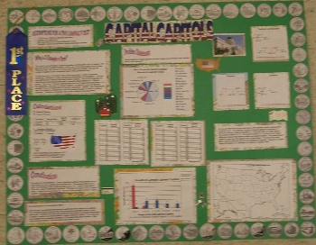
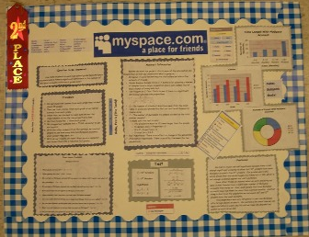
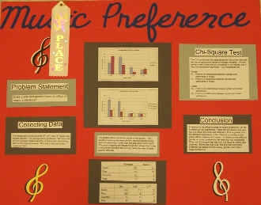
2008 Winners
2nd Place Winner
“myspace.com: a place for friends”
1st Place Winner
“Capital Capitols”
3rd Place Winner
“Music Preference”
1st Place
Anna Salvaggio and Frank Yoskovich (Macomb Mathematics Science
Technology Center, Warren)
Tammy Hsia and Christopher Bush (Macomb Mathematics Science
Technology Center, Warren)
Brad Barry and Brandon Cadrette (Macomb Mathematics Science
Technology Center, Warren)

Slide 17
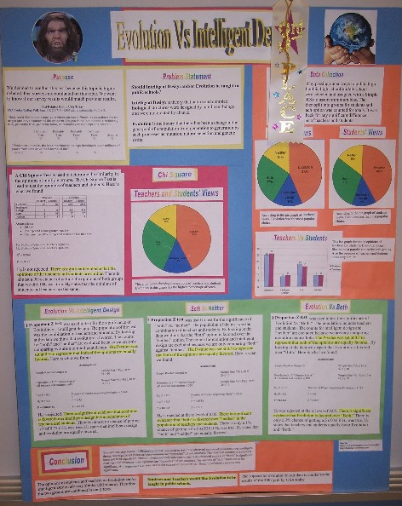
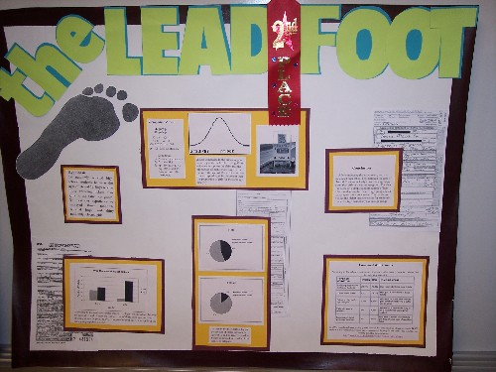
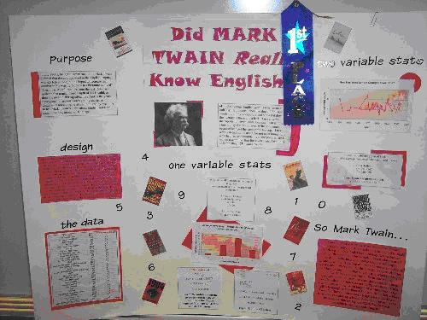
2009 Winners
1st Place
“Did Mark Twain Really Know English?”
2nd Place
“The Lead Foot”
“Evolution vs. Intelligent Design”
Lance Henkel and Tayson Lin
(Macomb Mathematics Science
Technology Center)
Hema Karunakaram (Saline High School)
Alaraya Holmberg and Miranda Rohrbough (Montague High School)

Slide 18
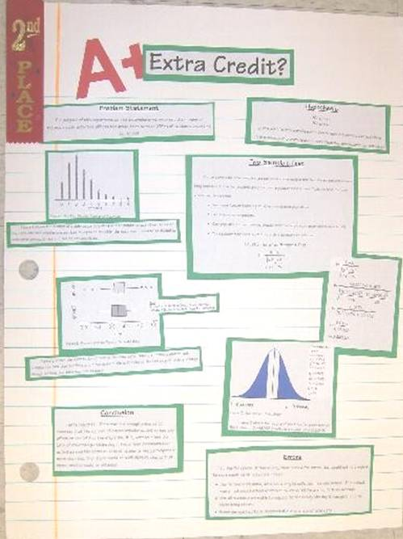
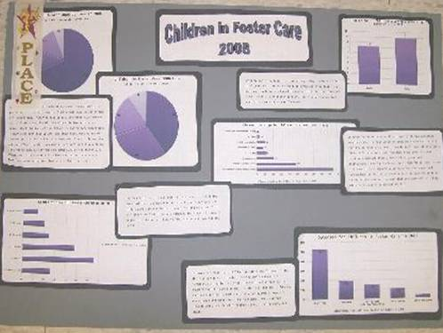
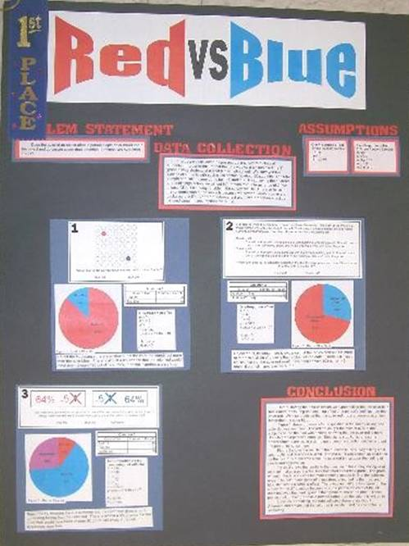
2010 Winners
2nd Place
3rd Place
1st Place
3rd Place Julie Frank (Kensington Woods High School
1st Place Sydney Kieler and Nick Higgins (Macomb Math Science Tech Center)
2nd Place Kevin Weinert and Michael Richards (Macomb Math Science Tech Center

Slide 19
2011 Winners
1st PlaceWinners “Red vs. Blue”
2nd Place Winners “Extra Credit”?
3rd Place Winners “Children in Foster Care 2008”
Nick Higgins and Sydney Kieler (Macomb Mathematics
Science Technology Center, Warren)
Michael Richards, Kevin Weinert (Macomb Mathematics
Science Technology Center, Warren)

Slide 20
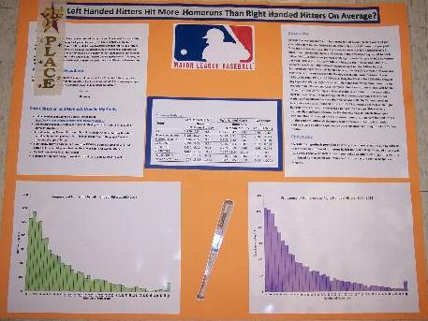
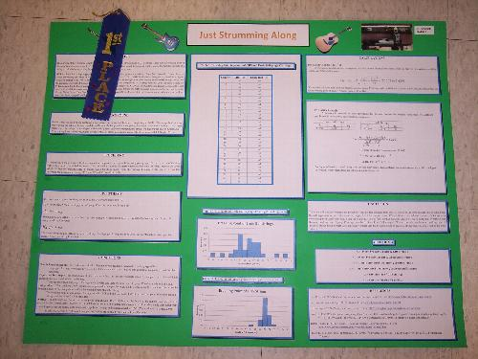
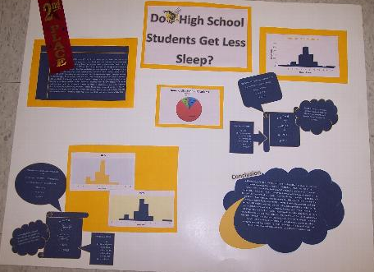
2012 Winners
3rd Place “Do Left-Handed Hitters Have More Homeruns
Than Right-Handed Hitters
1st Place “ Just Strumming Along”
2nd Place “Do High School Students Get Less Sleep?”
Madeline McFee & Naomi Joseph, Battle Creek Mathematics &
Science Center
Amanda Messina, Saline High School
John Caleb Ashby, Saline High School

Slide 21
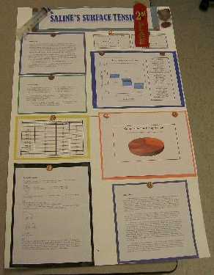
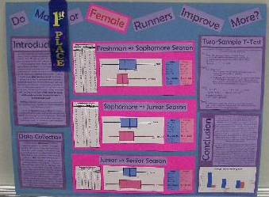
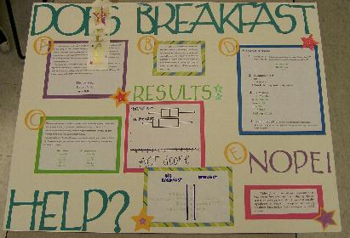
2013 Winners
2nd Place “Saline’s Surface Tension”
3rd Place “Does Breakfast Help ACT Scores?”
1st Place “Do Male or Female Runners Improve More?”
Kelly Hall, Saline High School
Nicki Kasza & Grace Campbell, Saline High School
Sushrut Athavale & Victor Chen, Saline High School

Slide 22
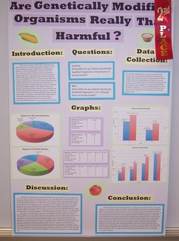
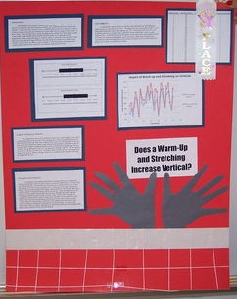
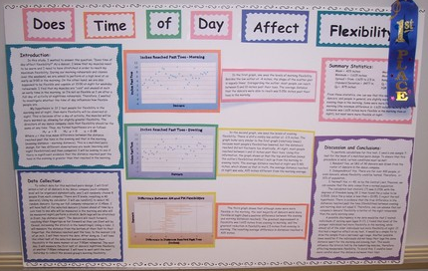
2014 Winners
3rd Place
2nd Plance
1st Place

Slide 23
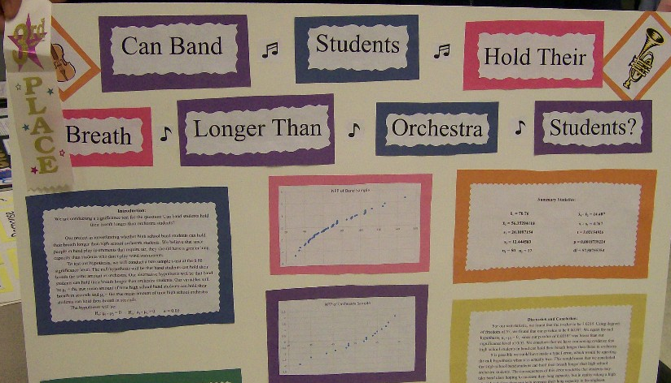
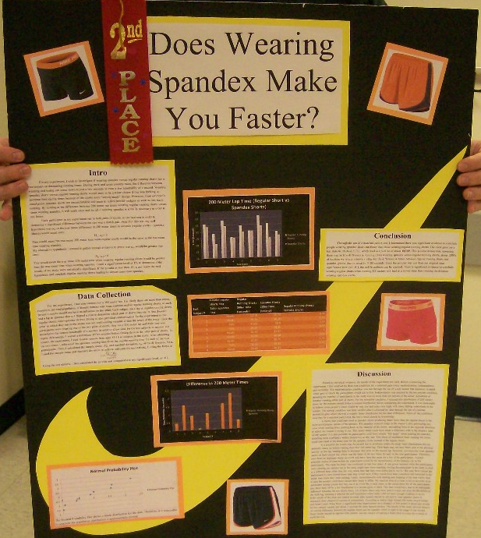
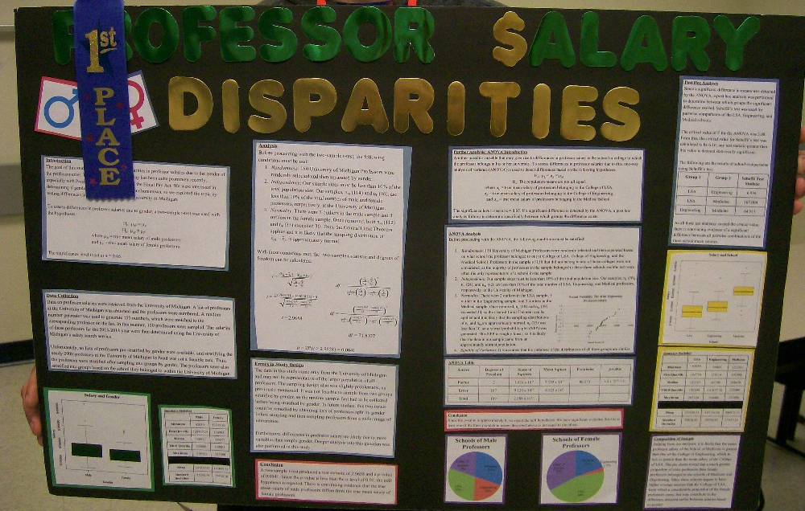
2015 Winners
2nd Place Winner
3rd Place winner
1st Place Winner
Victor Chen, Kera Yang, Saline High School, "Professor Salary Disparities"
Kyle Boxeth, Michael Chen, Saline High School, "Can Band Students Hold Their Breath Longer Than Orchestra Students?"
Abby M Rentschler, Saline High School, "Does Wearing Spandex Shorts Improve Running Times?"

Slide 24
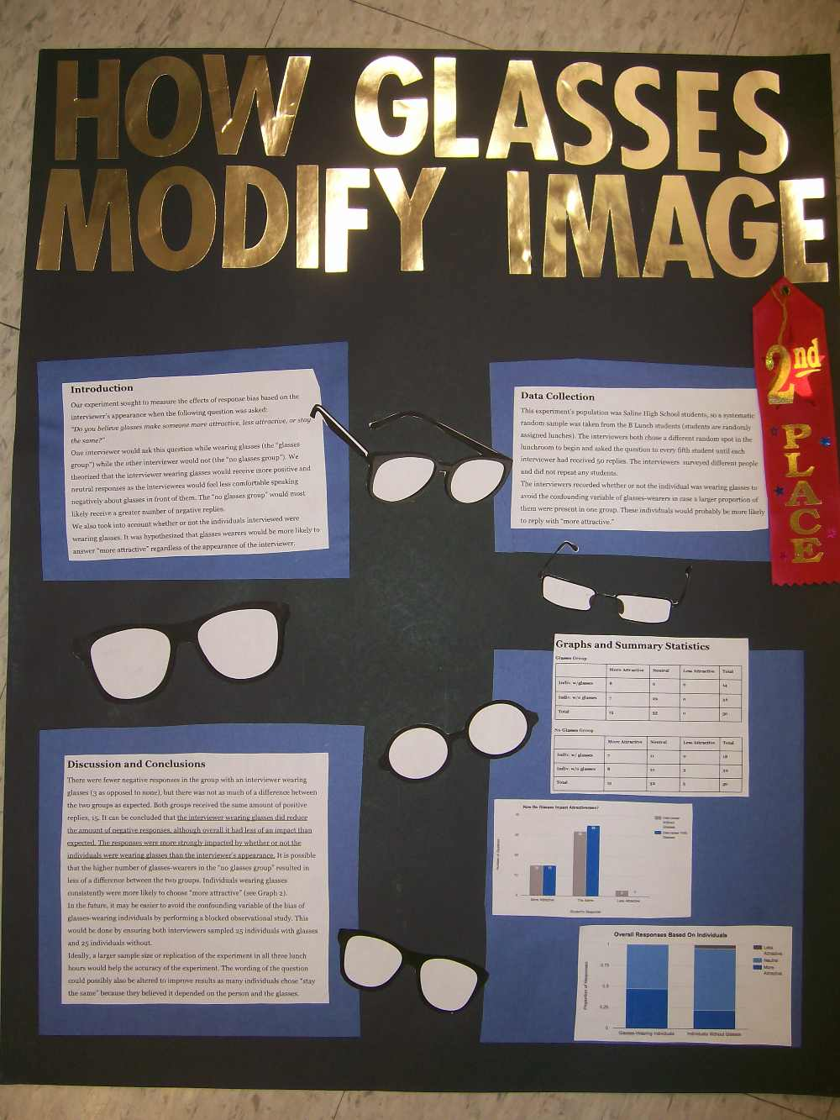
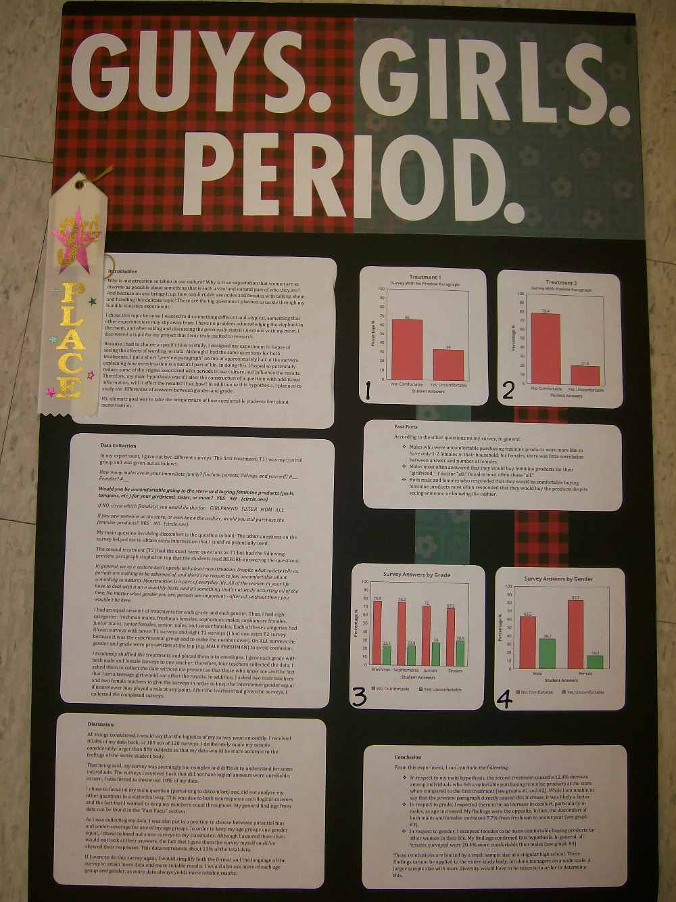
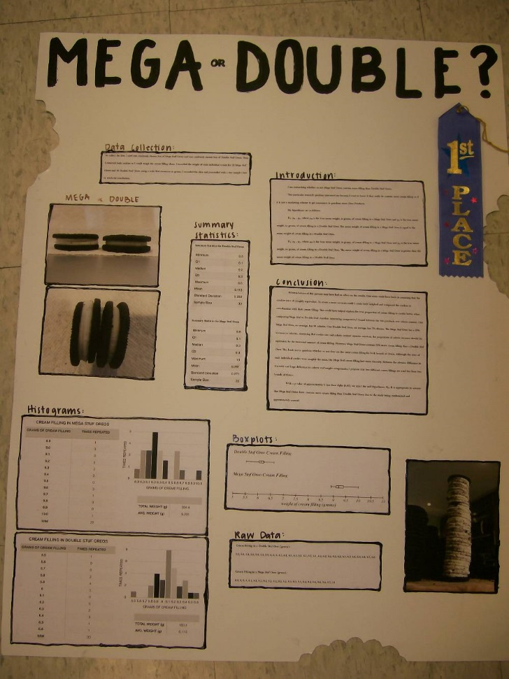
2016 Winners
1st Place
2nd Place
3rd Place
Emma Dester, Madeleine Haase, Saline High School, “How Glasses Modify Image”
Gillian Walter, Saline High School, “Mega Or Double?”
Kaylee Klepaczyk, Saline High School, “Guys. Girls. Period.”

Slide 25

Quiz
Question 1: How many students in a group?
A
6
B
4 or 5
C
2 or 3
D
1

Slide 26
Quiz
Question 2: According to the link on the GVSU web site, what is the key to creating a good poster?
A
Finding data that is easy to access
B
Using only adults in your survey to prevent response bias
C
Using a topic from a previous winner
D
Finding a topic you enjoy and are interested in

Slide 27
Quiz
Question 3: According to the GVSU website, name 4 ways to collect data
A
Survey, Observe, Experiment, or use Published Data
B
Survey, Observe, Experiment, or Make up Data
C
Survey, Test Subjects, Experiment, or have Subjects Volunteer
D
Observe, Test units, Experiment on units or use Practical Data

Slide 28



Quiz
Question 4: How many graphs must your poster display?
A
only 1
B
at least 2
C
at most 3
D
exactly 4

Slide 29
Quiz
Question 5: Who will supply the poster board?
A
You and your partner must buy your own
B
Mrs. Cybulski has plenty for everyone!
C
Your parents must supply you with all your school supplies
D
You will need to run a fundraiser to collect money for all boards

Slide 30








Quiz
Question 6: How does the GVSU website define a qualitative variable?
A
Text and Numbers
B
Numbers and Words
C
Text and Words
D
Numbers

Slide 31
Quiz
Question 7: How does the GVSU website define a quantitative variable?
A
Text and Numbers
B
Numbers and Words
C
Text and Words
D
Numbers

Slide 32
Quiz
Question 8: As defined by the GVSU website, a continuous variable is
A
A number that takes on only certain values in a range of numbers
B
A number that means infinity
C
A number that takes on only one value
D
A number that takes on all values in a range of numbers

Slide 33
Quiz
Question 9: As defined by the GVSU website, a discrete variable is
A
A number that takes on only certain values in a range of numbers
B
A number that means infinity
C
A number that takes on only one value
D
A number that takes on all values in a range of numbers

Slide 34
Quiz
Question 10: What are the most appropriate graphs for displaying continuous quantitative variables or numerical values that have been grouped together.
A
Histograms, Stem and Leaf Plots and Box and Whisker Plots
B
Bar Graphs and Pie Charts
C
Bar Graphs, Pie Charts and Line Graphs
D
Dot Plots, Stem and Leaf Plots, and Pie Charts

Slide 35
Quiz
Question 11: What are the most appropriate graphs for displaying qualitative variables or discrete quantitative variables
A
Histograms, Stem and Leaf Plots and Box and Whisker Plots
B
Bar Graphs and Pie Charts
C
Dot Plots and Histograms
D
Dot Plots and Stem and Leaf Plots

Slide 36
Congratulations You Have Successfully Completed the Statistics Poster Intro!

Slide 37

You’re Right!

Slide 39

You’re Right!

Slide 41
You’re Right!

Slide 43
You’re Right!

Slide 45
You’re Right!

Slide 47
You’re Right!

Slide 49
You’re Right!

Slide 51
You’re Right!

Slide 53
You’re Right!

Slide 55
You’re Right!

Slide 57
You’re Right!

Slide 59

Try Again!

Slide 61
Try Again!

Slide 63
Try Again!

Slide 65
Try Again!

Slide 67
Try Again!

Slide 69
Try Again!

Slide 71
Try Again!

Slide 73
Try Again!

Slide 75
Try Again!

Slide 77
Try Again!

Slide 79
Try Again!

Slide 80
You’re Right!

Slide 81
Congratulations You Have Successfully Completed the Statistics Poster Intro!

Slide 82
Congratulations You Have Successfully Completed the Statistics Poster Intro!

